Slide 1
Unattended operation/Experiment in progress
Materials/Chemicals used:
CHEMICAL HAZARD CATEGORIES
Compressed Gas Halogenated Solvents
Heavy Metals Oxidizers
Mineral Acids Organic Acids
Bases Reactive Wastes
Corrective Action in case of emergency
Contact information for faculty or staff running experiment must be listed below.
Name: Number:
For Emergency Assistance (24 hrs): 9-1-1
EKU Police: 859-622-1111

Slide 2
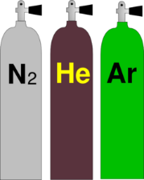
Sign Symbols
Please Refer to the Chemical Safety Signage Guide to determine the use for each symbol
Only a maximum of eight symbols per page, if more than eight are needed, then use separate pages
Use the Check Mark for the necessary Chemical Categories.
NO FOOD or DRINK
☑
EYE PROTECTION REQUIRED
LAB COAT REQUIRED
TOXIC CHEMICALS
RADIOACTIVE MATERIAL
EXPLOSIVE
HIGH VOLTAGE
RESTRICTED ACCESS
CHEMICAL STORAGE AREA
BIOHAZARD
C
LASER RADIATION
CANCER HAZARD
MAGNETIC FIELD
CORROSIVE
COVERING SHOES NEEDED
FLAMMABLE
GAS CYLINDERS
OXIDIZING

Slide 3
FLAMMABLE
Oxidizer
Corrosive
Toxic
Irritant/ toxic
Health/toxic
Environmental hazard
Gas cylinder
explosive
GHS pictograms

Slide 4
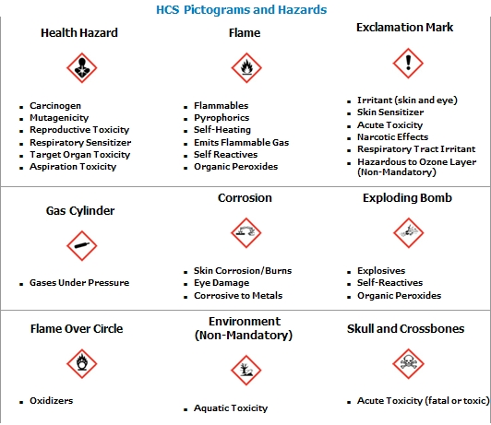
GHS pictogram and hazards

