Slide 1
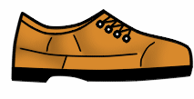



Instrument Lab 5124
Department of Chemistry NSCB
CAUTION
NO FOOD or DRINK
EYE PROTECTION REQUIRED
COVERING SHOES NEEDED
TOXIC CHEMICALS
RESTRICTED ACCESS
HIGH VOLTAGE
CORROSIVE
FLAMMABLE
Necessary Information: Some glassware may be under reduced pressure.
CHEMICAL CATEGORIES
Compressed Gas Halogenated Solvents
Heavy Metals Oxidizers
Mineral Acids Organic Acids
Bases Reactive Wastes
☑
☑
☑
☑
ACCESS TO AUTHORIZED PERSONNEL ONLY
CONTACT | NAME | LOCATION | PHONE | Alt. PHONE
Main Supervisor
In Emergency | Dekia Gaither | Burnam House | 622-3437 | 859-979-3117
In Emergency | Bryan Makinen | Adams House/Gentry Bld. | 622-2421 | 859-893-6503
For Emergency Assistance (24 hrs): 9-1-1
EKU Police: 859-622-1111
Date Posted: February 2022

Slide 2





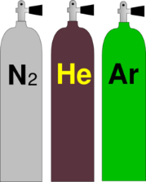

Sign Symbols
Please Refer to the Chemical Safety Signage Guide to determine the use for each symbol
Only a maximum of eight symbols per page, if more than eight are needed, then use separate pages
Use the Check Mark for the necessary Chemical Categories.
NO FOOD or DRINK
☑
EYE PROTECTION REQUIRED
LAB COAT REQUIRED
TOXIC CHEMICALS
RADIOACTIVE MATERIAL
EXPLOSIVE
HIGH VOLTAGE
RESTRICTED ACCESS
CHEMICAL STORAGE AREA
BIOHAZARD
C
LASER RADIATION
CANCER HAZARD
MAGNETIC FIELD
CORROSIVE
COVERING SHOES NEEDED
FLAMMABLE
GAS CYLINDERS
OXIDIZING

Slide 3








FLAMMABLE
Oxidizer
Corrosive
Toxic
Irritant/ toxic
Health/toxic
Environmental hazard
Gas cylinder
explosive
GHS pictograms

Slide 4
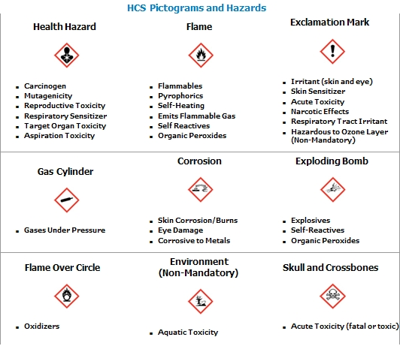
GHS pictogram and hazards

